Slide 1




Delhi Air Quality Prediction

Slide 2




Project Supervision& Team Members
Supervised by:
•Dr. Yasmin Mahmoud
Teaching Assistants:
• Eng. George
• Eng. Ahmad Gomaa
Project Team Members
Jumana Hazim
•Mahmoud Ashry
•Sohaila Abdelnasser
Rawan Mahmoud
Omar ElSherbiny
Ahmed Mahmoud

Slide 3

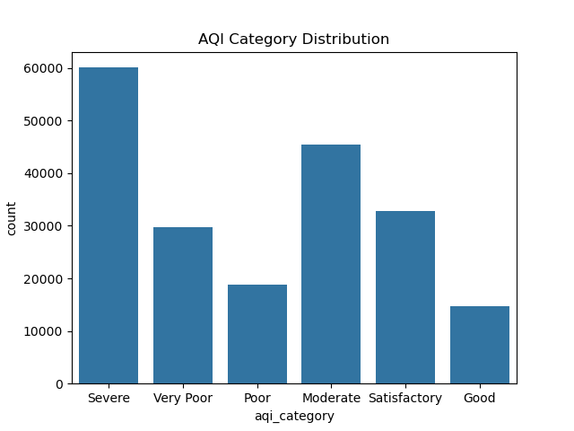



Slide 4




Analysis: The dataset shows a clear imbalance, with the "Severe" category being the most frequent, followed by "Moderate".
Insight: This high frequency of severe pollution levels highlights the critical air quality situation in Delhi.
Impact: Our model must be robust enough to accurately distinguish between these different categories to provide reliable health alerts.

Slide 5
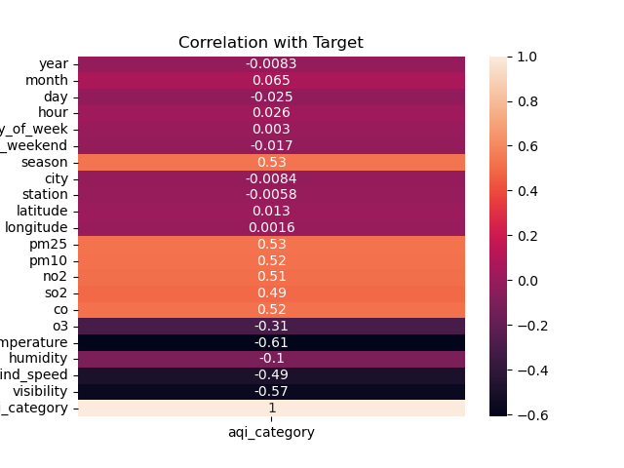

Slide 6

Understanding Influencers: This heatmap illustrates how each variable correlates with the Air Quality Category.
Pollutant Impact: High positive values for PM2.5, PM10, and CO (around 0.52) confirm they are the primary drivers of poor air quality.
Weather Factors: A strong negative correlation with Temperature (-0.61) suggests that colder conditions in Delhi are often associated with higher pollution levels.
Selection Strategy: We selected features with the highest correlation scores to ensure the model focuses on the most relevant data

Slide 7

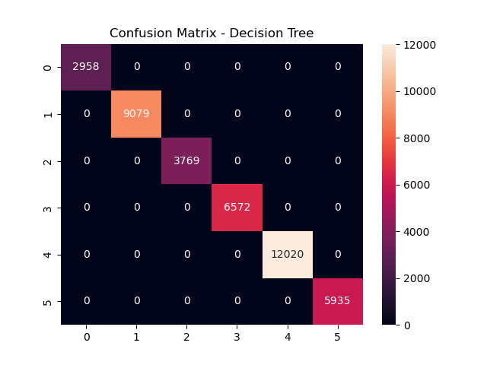

Slide 8
Prediction Accuracy: The Confusion Matrix for the Decision Tree model shows a perfect diagonal alignment.
Interpretation: This means the model correctly classified every single instance in
the test set without any misclassifications between the AQI categories.
Reliability: Such high precision indicates that the features we selected (like PM2.5 and Temperature) provide very clear patterns for the model to distinguish between "Good" and "Severe" air quality

Slide 9
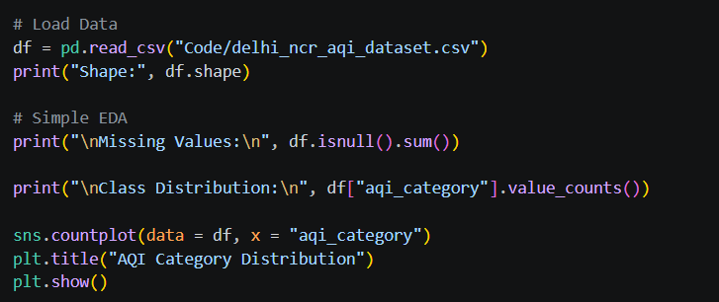
Data Ingestion: Reading the dataset and checking its dimensions.
Exploratory Data Analysis (EDA): Checking for null values and visualizing the distribution of the target variable (aqi_category).

Slide 10

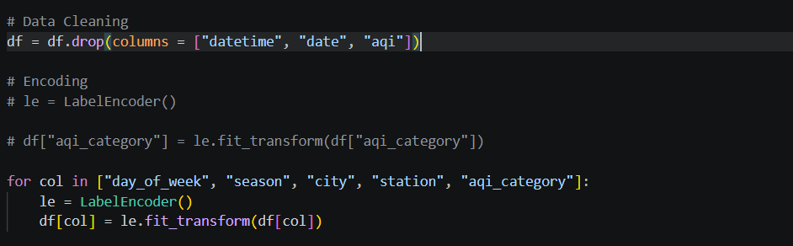

Cleaning: Removing time-related columns that are not needed for the classification task.
Feature Encoding: Using LabelEncoder to transform categorical text labels into numerical format for the model.

Slide 11
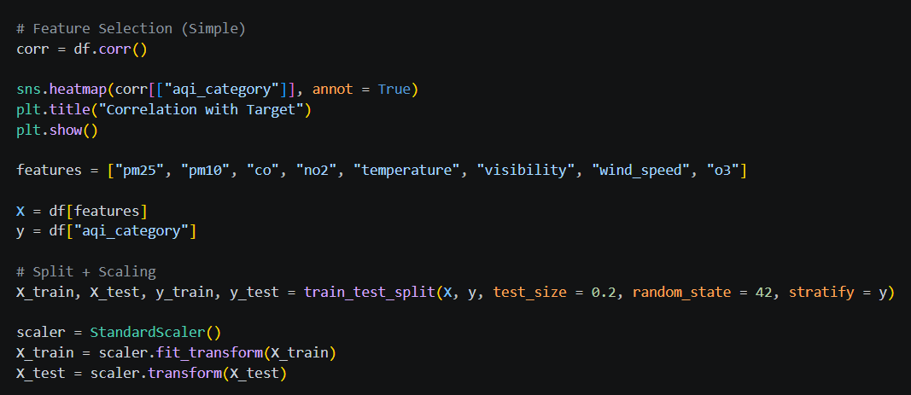

Feature Importance: Using a heatmap to confirm correlations with the target.
Scaling: Applying StandardScaler to normalize the data ranges.
Splitting: Dividing the dataset into 80% training and 20% testing sets.

Slide 12
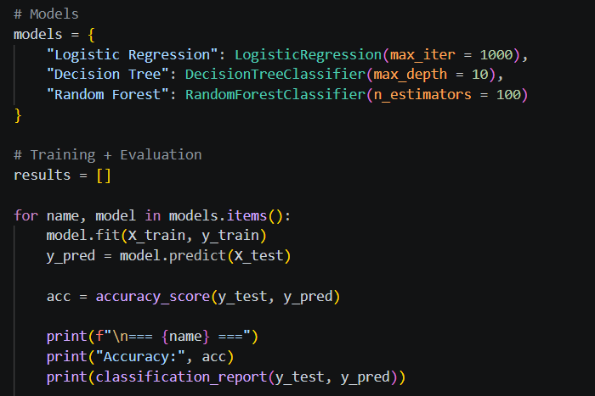

Model Selection: Using a variety of algorithms (Linear, Tree-based, and Ensemble) to compare their predictive power.
Automated Workflow: Implementing a loop to train each model on the training set and generate predictions on the test set.
Efficiency: This approach allows us to evaluate multiple strategies simultaneously under the same conditions

Slide 13

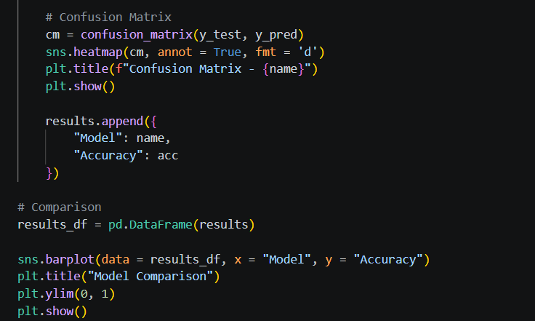


Slide 14


Performance Assessment: Using the Confusion Matrix to see exactly where the model succeeded or struggled in classifying air quality.
Accuracy Comparison: The bar chart visualizes the performance of all models, clearly highlighting the most effective one.
Final Conclusion: Random Forest emerged as the best performer, providing the highest accuracy for Delhi's complex air quality patterns.

Slide 15

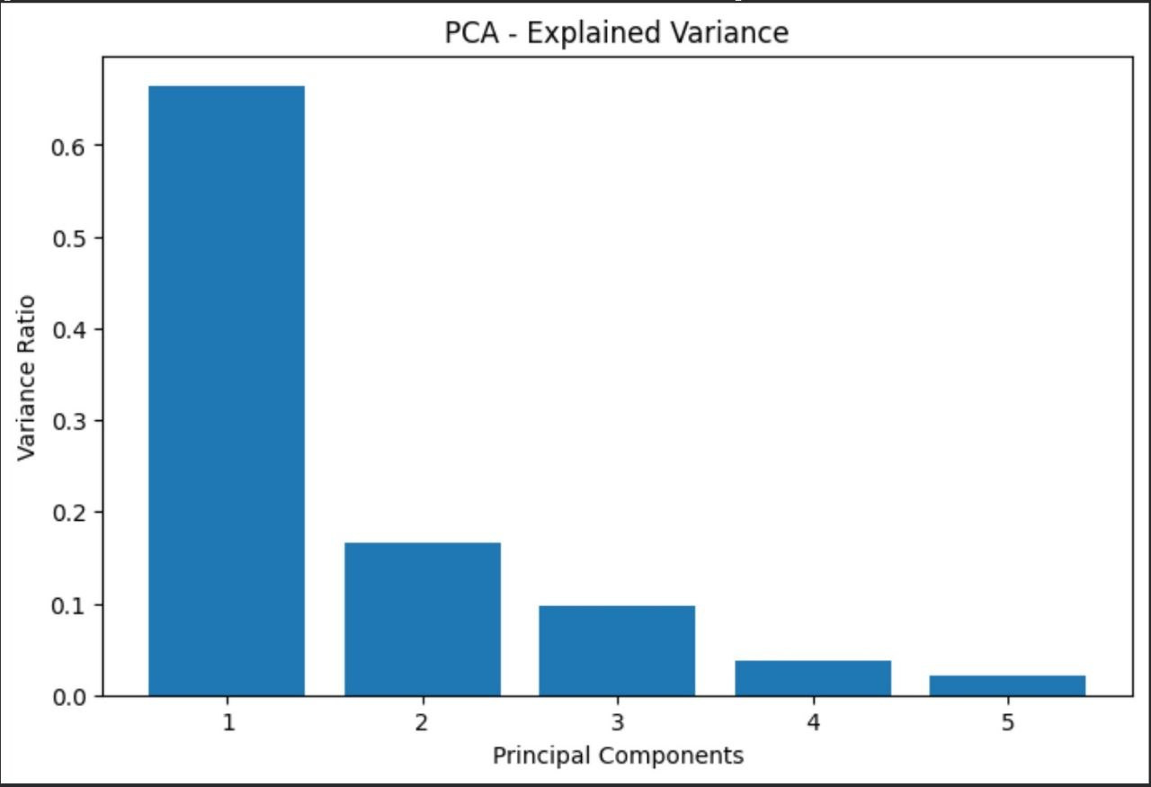

Exploratory Data Analysis (EDA)
Description: This figure shows the distribution of AQI categories in the dataset. It helps identify whether the dataset is balanced or imbalanced across different air quality levels

Slide 16
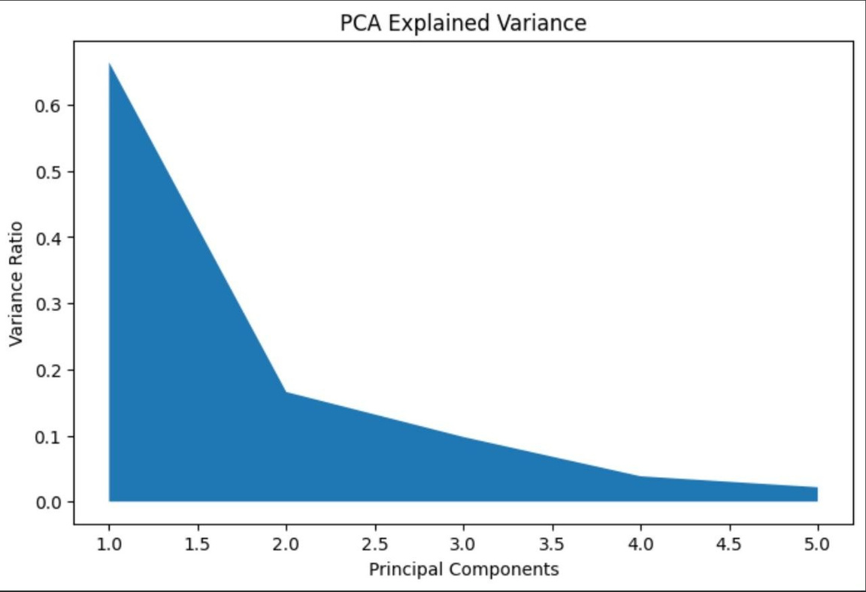
Dimensionality Reduction
Description: This figure shows how much variance is explained by each principal component. It helps in reducing dimensionality while preserving important information

Slide 17
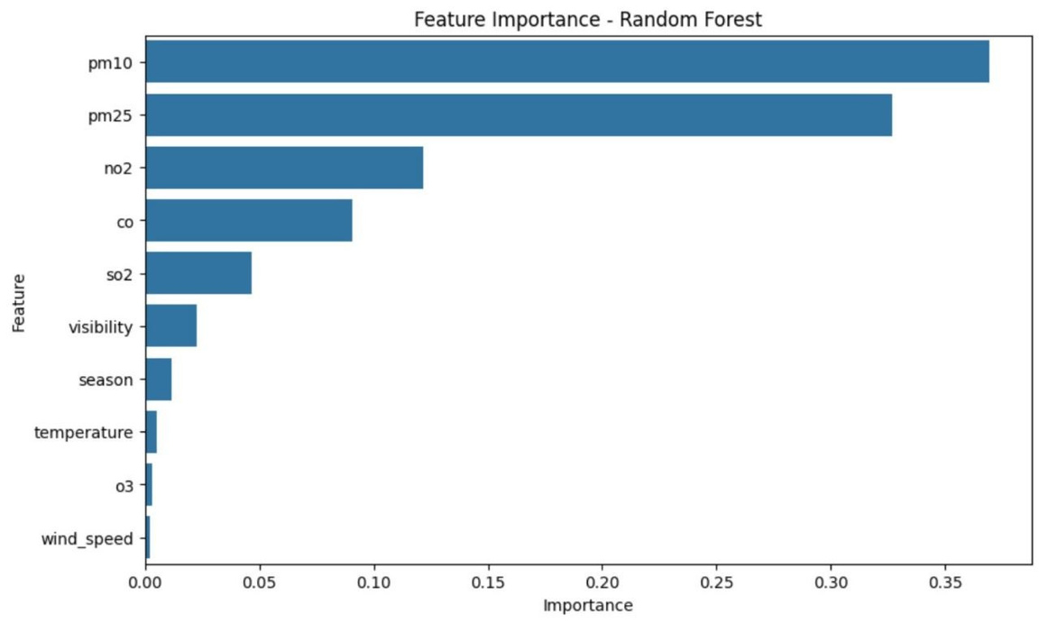
Feature Importance (Random Forest)
Description: This figure shows the importance of each feature in predicting AQI. Pollutants like PM2.5 and PM10 have the highest impact

Slide 18
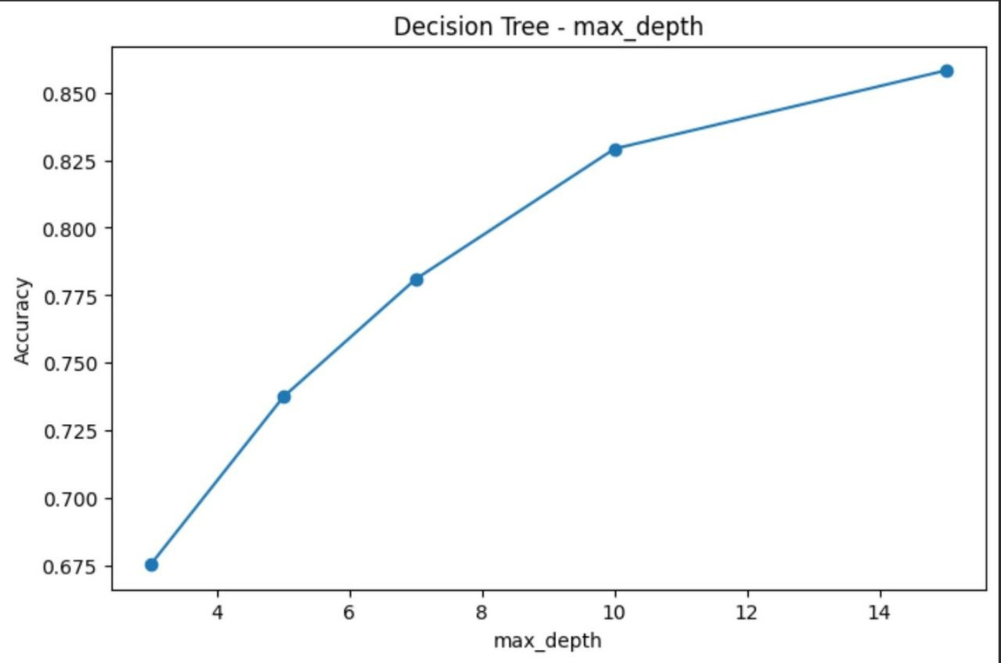
Decision Tree – Max Depth vs Accuracy
Description: Shows how changing tree depth affects model performance and helps control overfitting

Slide 19
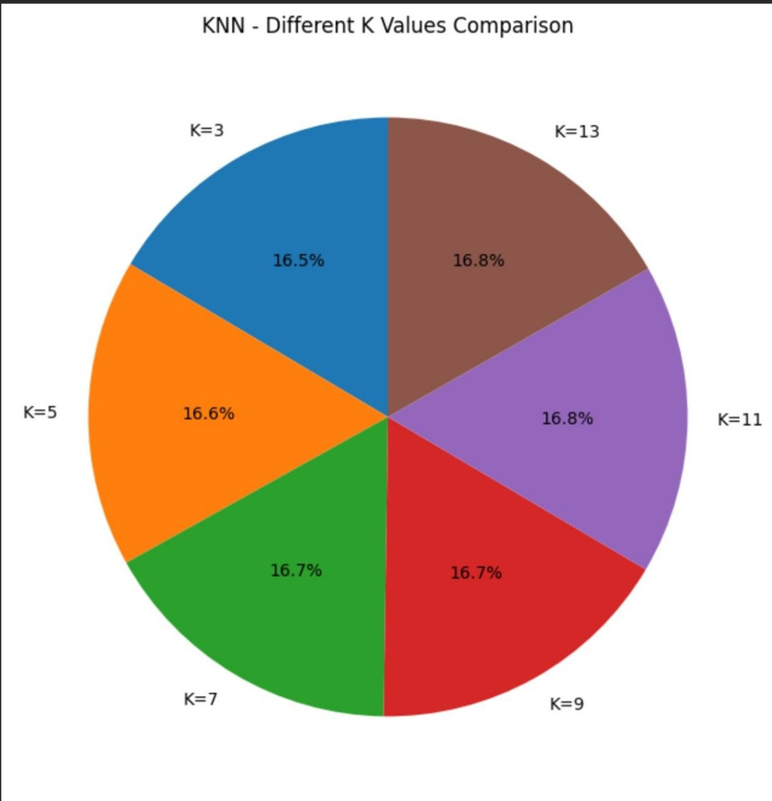
KNN – Different K Values Comparison
Description: Compares performance across different K values.

Slide 20
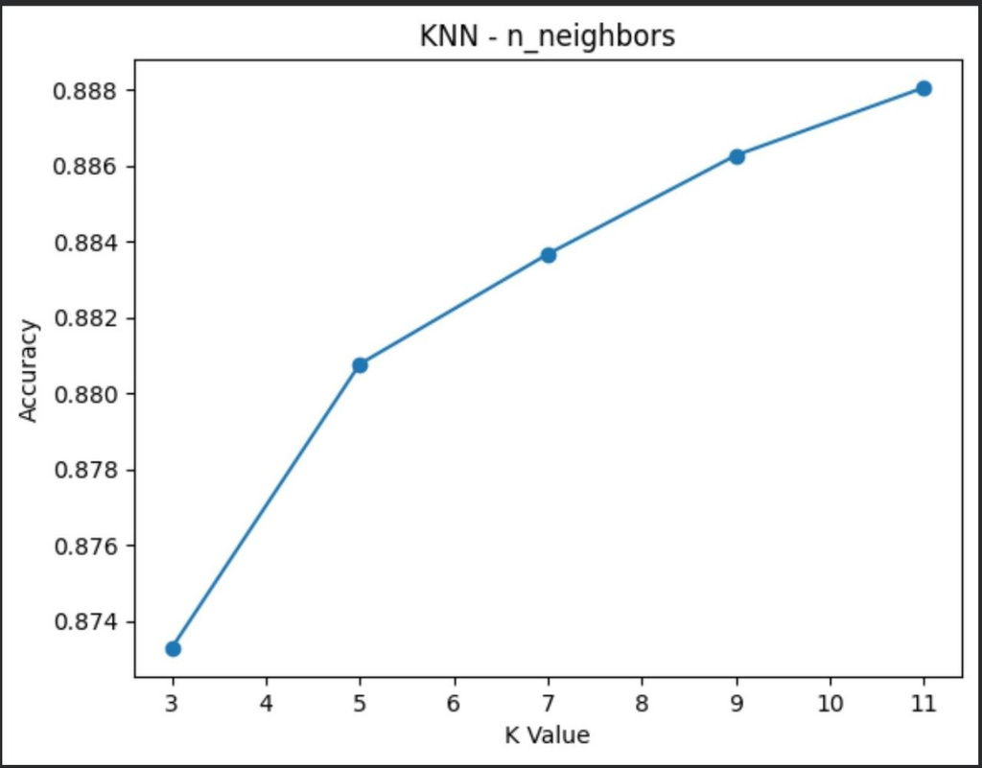
KNN – Optimal Number of Neighbors (K)
Description: Shows relationship between K value and model accuracy

Slide 21
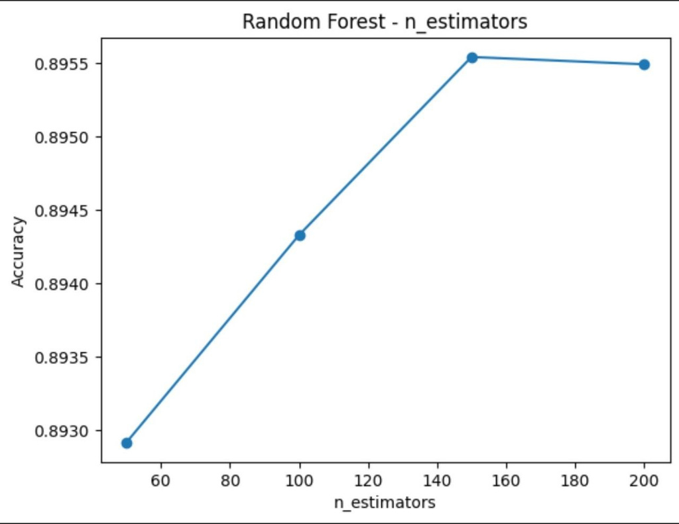
: Random Forest – Number of Estimators vs Accuracy
Description: Shows how increasing number of trees improves model performance until it stabilizes

Slide 22
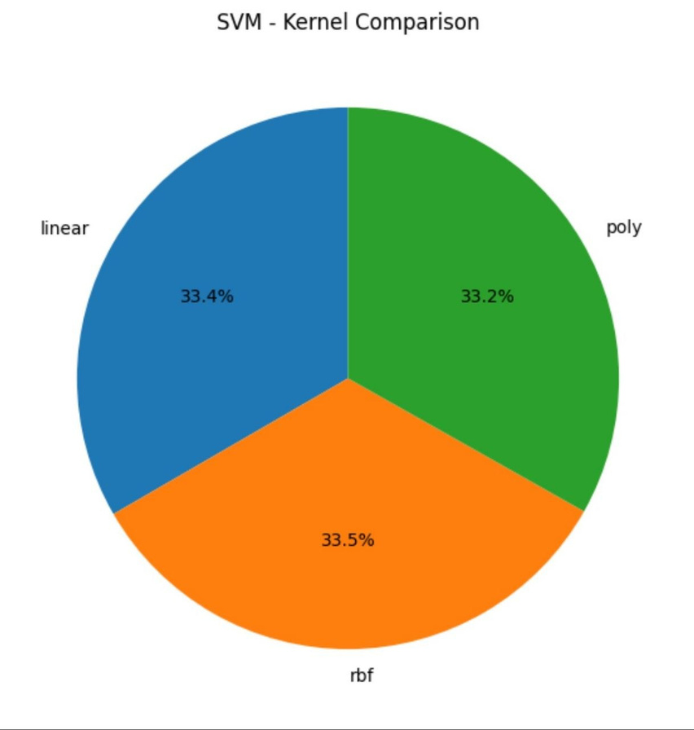
SVM Kernel Comparison
Description: This figure illustrates the comparison between different SVM kernels: Linear, RBF, and Polynomial.

Slide 23

Thank
You

